Slide 1
Introduction to the Exoplanet Science Yield sub-Working Group (ESYWG)
Full Membership Meeting
4/04/2024
Chris Stark
NASA GSFC
christopher.c.stark@nasa.gov
Dmitry Savransky
Cornell

Slide 2
What is the ESYWG? Our Charter:
Provide multiple independent estimates of scientific productivity of HWO’s exoplanet imaging instrumentation to guide START and TAG efforts.
Standardize astrophysical assumptions and calibrate exposure times/yields
Estimate the exoplanet yields obtained via high contrast imaging to:
Aid TAG efforts by benchmarking architectures, guiding and identifying key trade studies, and mapping sensitivities to bulk mission parameters
Aid START efforts by evaluating yields for different science goals/metrics, informing target selection and survey design

Slide 3
Where is the ESYWG (in the “org chart”)?
START = Science, Technology, Architecture Review Team (the science-ish team)
TAG = Technical Assessment Group (the engineering-ish team)
START
Joint & Community
TAG
Galaxy Growth
Ravindranath & Postman
Living Worlds
Arney & Parenteau
DEIA & Mentorship
Scannapieco & TBD
Science Case Simulation
Batalha & Osten
Systems
Menzel & Shaklan
Evolution of the Elements
Lee & Scowen
Solar System in Context
Robinson & Shkolnik
GOMAP Synergies for Future Missions
Gaskin & Oschmann
Science Data Simulation
Greene & Tumlinson
Integrated Modeling
Levine & Liu
Ground-Based Astronomy in the 2030s/2040s
Lopez-Morales & Miyazaki
Communications
Schirner & Straughn
Science-Engineering Interface
Morrissey & Sitarski
Technology
Bolcar & Zhao
Space-Based Astronomy in the 2030s/2040s
Petre & Kataria
Artificial Intelligence & Machine Learning
Ansdell & Dean
Past Studies Comparison
Gaudi
Servicing
Van Campen & Grunsfeld

Slide 4
Science Case Simulation Working Groups
Science Case Simulation |  | JWG | Natasha Batalha (Ames) | Rachel Osten (STScI) | Aki Roberge | Develop codes to simulate returns from potential HWO science cases, starting with three needed to help design an integrated science modeling framework.
Science Case Simulation | Astrometry | JWG | Scott Gaudi (Ohio State) |  | Josh Pepper | Investigate performing high-precision astrometry with HWO and develop a tool to model astrometry surveys with a wide-field camera.
Science Case Simulation | Exoplanet Direct Imaging Yields | JWG | Dmitry Savransky (Cornell) | Chris Stark (GSFC) | Aki Roberge | Simulate numbers of different kinds of exoplanets found in various HWO coronagraphic imaging surveys, and work to increase the fidelity of yield modeling codes.
Science Case Simulation | Galaxy Evolution in the UV | JWG | Edmund Hodges-Kluck (GSFC) | Médéric Boquien (Université Côte d'Azur) | John O'Meara | Simulate returns from a challenging galaxy evolution science case that uses multi-object ultraviolet spectroscopy.
https://docs.google.com/spreadsheets/d/1iIKG7u2gLjxv8XdYZSA-HG84odmjvOqC_LH6Xl13Ivs

Slide 5
Who is the ESYWG? You!
Plus our advisory committee:
Co-Leads: Chris Stark (NASA GSFC), Dmitry Savransky (Cornell)
Yields: Rhonda Morgan (JPL), Peter Plavchan (GMU), Corey Spohn (NASA GSFC/NPP), Tiffany Glassman (Northrop)
Stars: Natalie Hinkel (LSU)
Occurrence rates: Jessie Christiansen (NExScI), Steve Bryson (NASA ARC)
Exozodi: Miles Currie (UW)
Exoplanet Models/Retrievals: Renyu Hu (JPL), Natasha Latouf (NASA GSFC NSF GRF), Avi Mandell (NASA GSFC)
Astrobiology: Jake Lustig-Yaeger (JHU APL)
Coronagraphs: Kevin Fogarty (NASA ARC), Roser Juanola-Parramon (NASA GSFC/UMBC), Lucie Leboulleux (Grenoble), Dan Sirbu (NASA ARC)
WFSC: Bruce Macintosh (UCSC), Susan Redmond (Caltech)
Telescope/systems: Stuart Shaklan (JPL)
Exposure times/Detector/Roman: Bijan Nemati (Tellus1 Scientific), Sarah Steiger (STScI)
Stray light: Charley Noecker (JPL)

Slide 6
Liaisons to Other Working Groups/Subgroups
Science Case Simulation
Discovering Living
Worlds
Systems
Exoplanet Direct Imaging Yields
Stuart Shaklan
Natalie Hinkel
Target Stars and Systems
Jake Lustig-Yaeger
Discovering Living Worlds
Bruce Macintosh
Jessie Christiansen
Dan Sirbu
Renyu Hu
Understanding the Solar System in its Galactic Context
Technology
Science Data Simulation
Characterizing Exoplanets
High-Contrast
Coronagraphs
Demographics & Architectures of Planetary Systems

Slide 7
Purpose of the ESYWG General Membership Meetings
Provide updates on ESYWG plan & progress
Solicit your feedback and input on the plan
Help set task priorities and guide direction of work
Establish task groups to deliver key products
Task groups will meet outside of regularly scheduled meetings
Educate ourselves and share knowledge relevant to yield calculations
We will be hosting special topics covering yield calculation methods, inputs, etc.
Advisory committee members and volunteer general members can give these talks
Notes
We are not starting from scratch: we wish to build upon past efforts
We have two fairly mature yield modeling codes (AYO & ExoSIMS)
More are welcome, but must be provided– we are not creating a new yield code here
Our goal is not to create a single definitive yield code: rather is is to standardize and record all inputs and assumptions, and to verify that we understand the sources of discrepancies in yield predictions

Slide 8
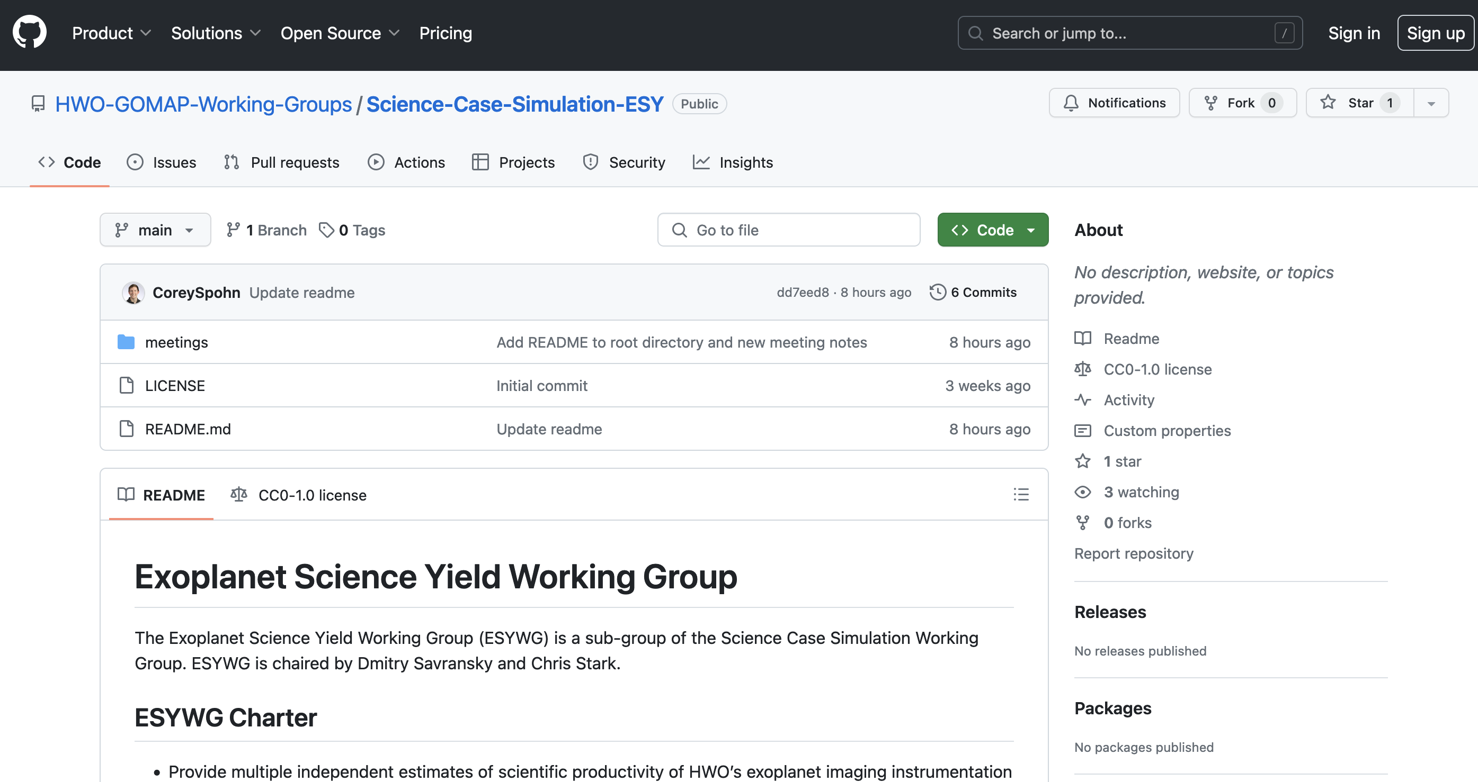
Logistics and Resources
Public Slack:
HWO_Community Slack, #esywg
Public GitHub repository:
https://github.com/HWO-GOMAP-Working-Groups/Science-Case-Simulation-ESY
Meeting notes, public documents, public code
Corey Spohn (NASA Goddard) is the POC

Slide 9


GOMAP-HWO Code of Conduct & Reporting Protocol
You must fill out the ESYWG follow-up survey to participate in this group. See e-mail.
NASA Astrophysics Division Statement of Principles
All participants in GOMAP-HWO activities must adhere to the APD Statement of Principles
American Astronomical Society (AAS) Code of Ethics
The AAS Code of Ethics is required to be followed under the APD Statement of Principles
Reporting Protocol
Follow the procedures in the APD Statement of Principles and contact the HWO GIG
Use institutional reporting channels, as appropriate
NASA-funded individuals have access to NASA programs (Ombuds, Anti-Harassment, ODEO) and a facilitator to help navigate the various options
Code of Conduct: https://docs.google.com/document/d/1flXRhnN8aPi82BrGkPUwmidMqmk8ikFlGiMsQtkvaeo

Slide 10
Goals, Plan of Work, & Timeline

Slide 11
ESYWG Products & Timeline
Goal: CML3 by ~Jan 2025
Key First Year Products
[02/2024] Establish comms. w/ Sci-Eng Interface WG to define required inputs for bounding architectures
[04/2024] Exposure time benchmarking report (coordinated w/ Data Simulation WG)
[06/2024] Document all assumptions w/ links to publicly available inputs; identify necessary updates
[06/2024] List of observation/survey strategies to investigate
[06/2024] Status update at START/TAG F2F meeting
[08/2024] Assessment of ExoEarth candidate yields and sensitivities for several architecture bounding cases
[10/2024] Preliminary assessment of alternative survey strategies[10/2024] Multi-dimensional grid of yields covering phase space of high-level mission parameters
Inputs/Outputs
Inputs: stellar catalog, exoplanet occurrence rates, exozodi occurrence rates, exoplanet albedos, observational requirements, possible observational strategies/ConOps, coronagraph simulations, observatory performance parameters, overhead estimates, PSF subtraction guidance
Outputs: yield estimates for a variety of planet types, exposure time estimates, list of high priority targets, list of observations

Slide 12
Update on Progress So Far

Slide 13
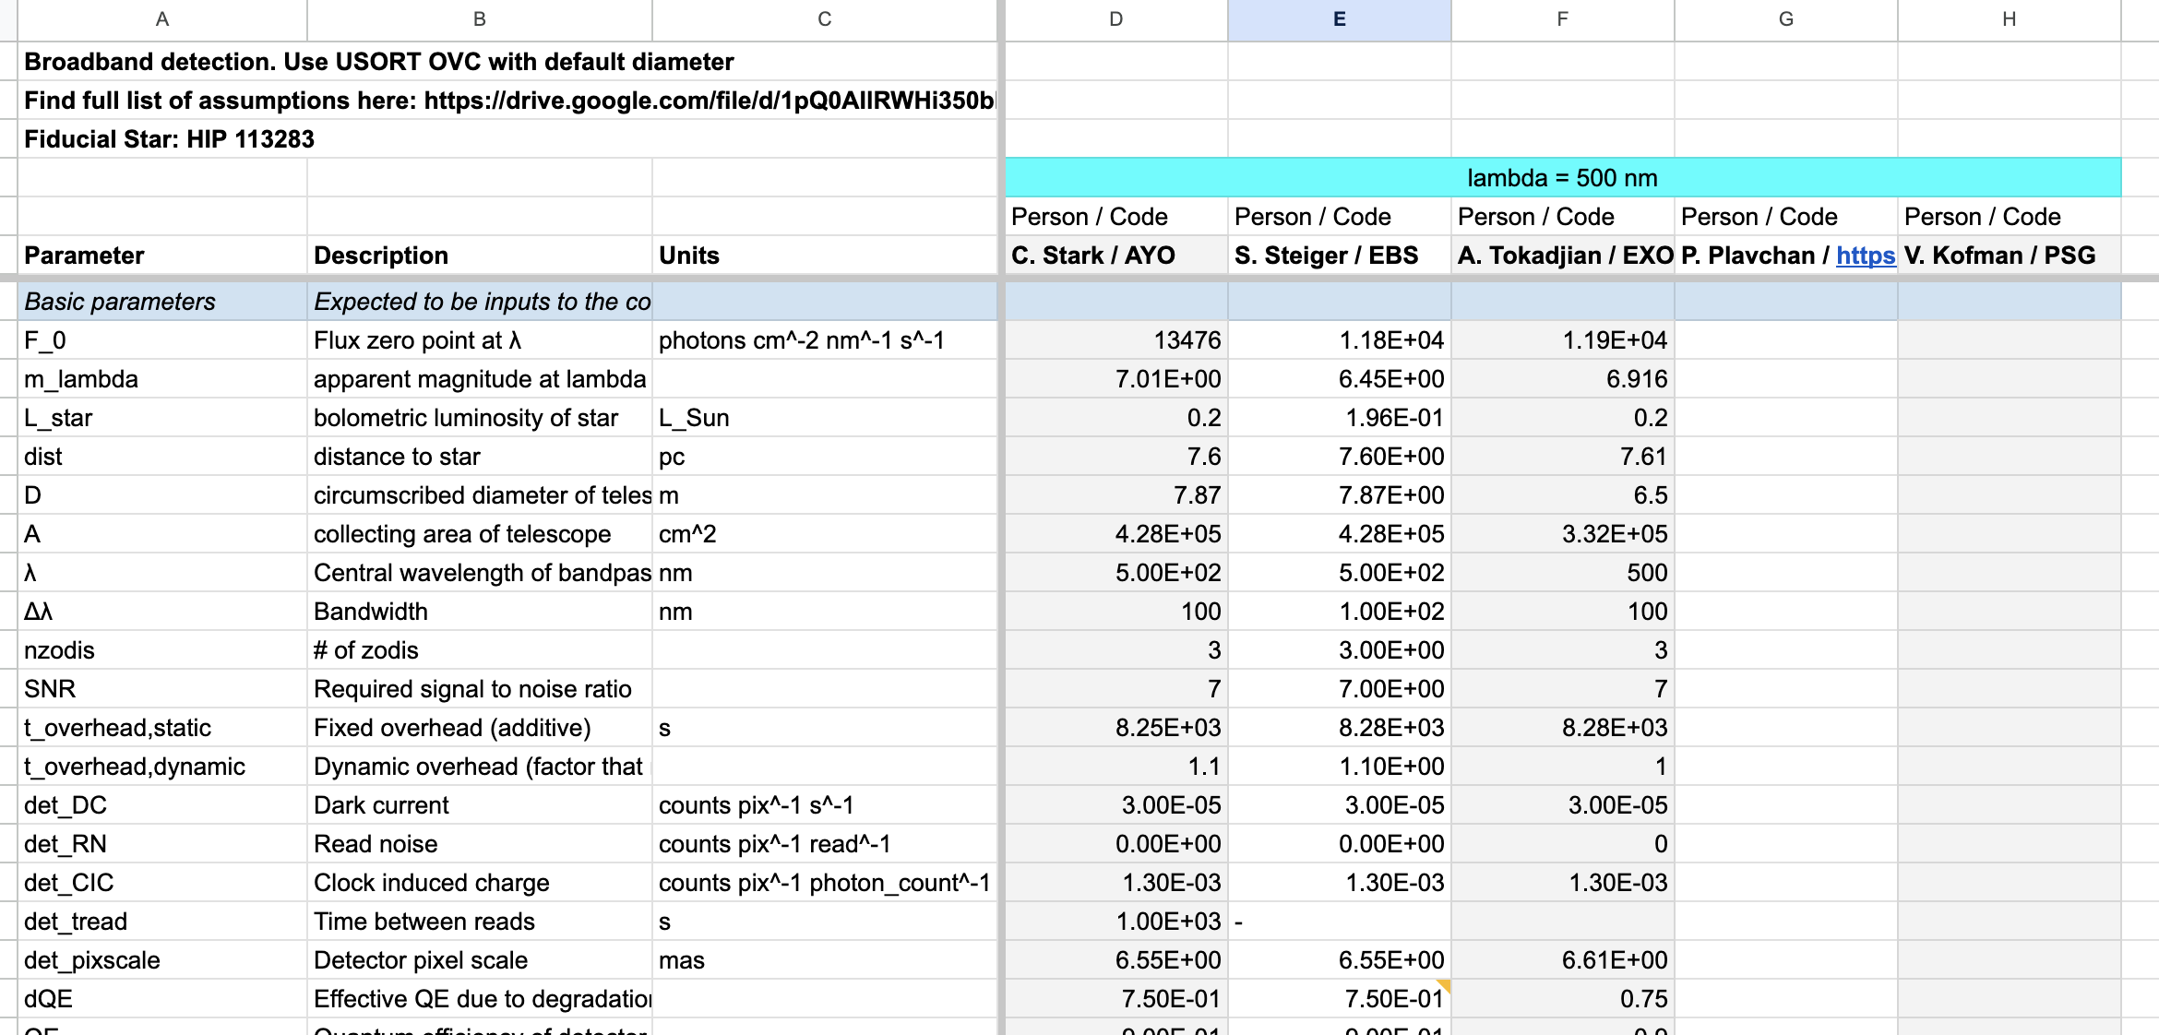
First Task: ETC Benchmarking/Cross-Model Validation
Identify existing ETCs
Agree on common inputs
Compare outputs and intermediate calculations
https://drive.google.com/drive/u/1/folders/1iURjzKsqGG6_EXyJRNEAadZU0Rc93ZJa

Slide 14
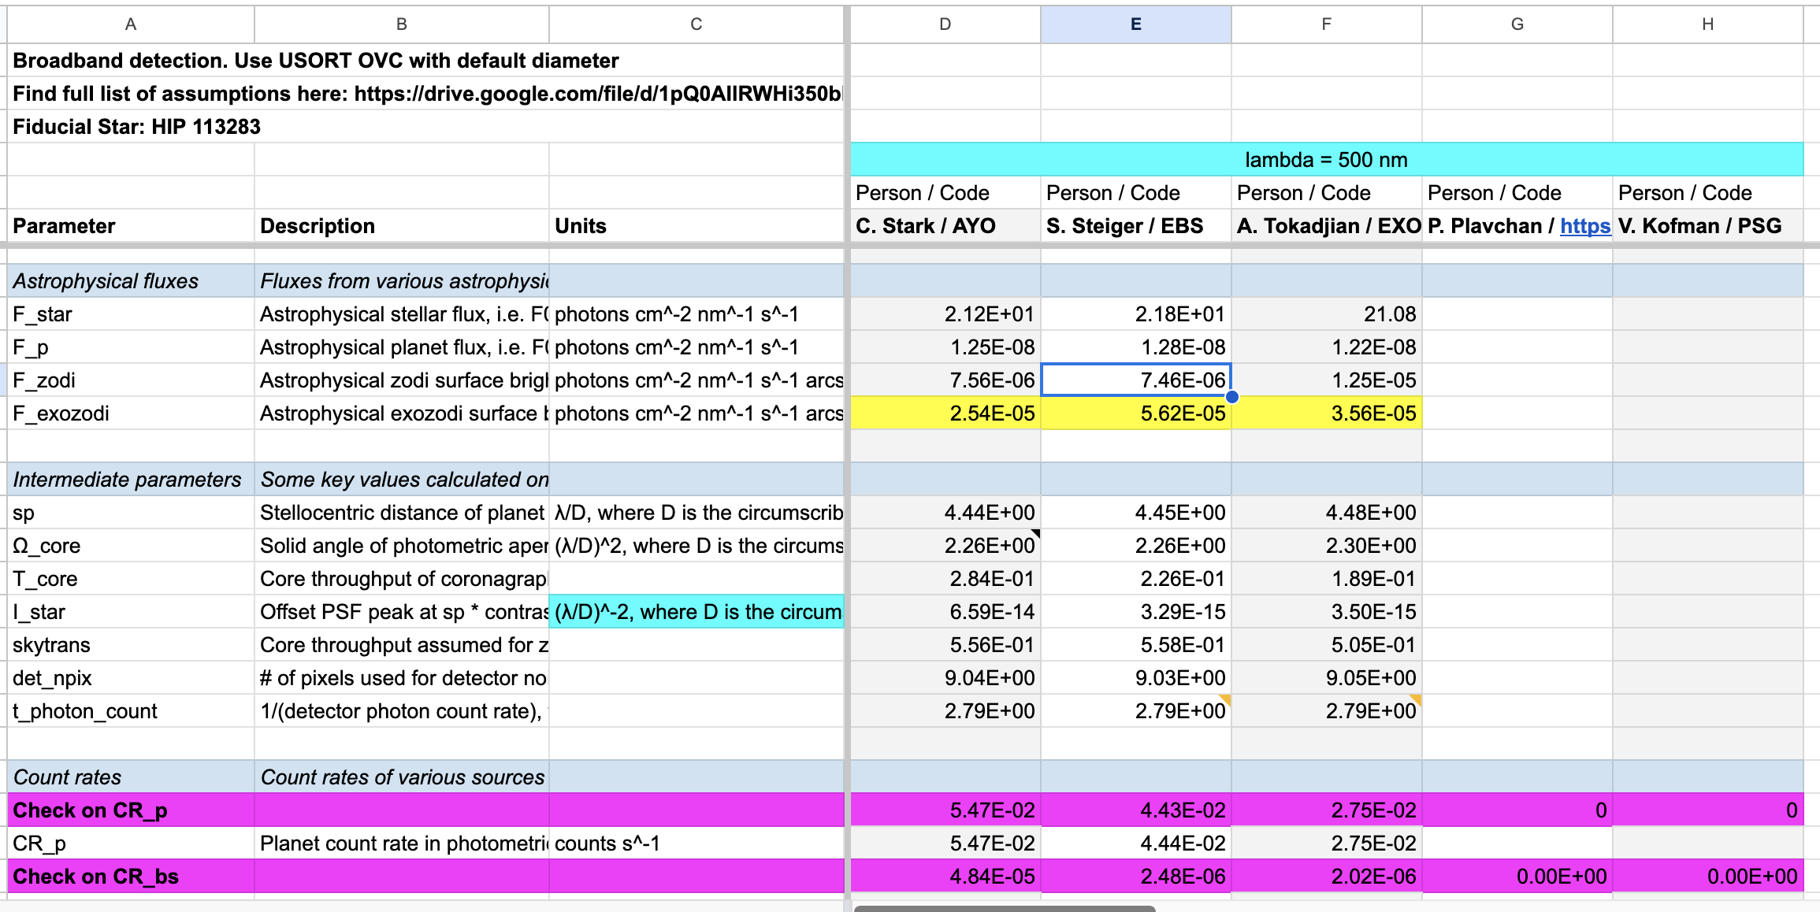
First Task: ETC Benchmarking/Cross-Model Validation
Roughly ~2/3 finished
Participation in this is open to anyone interested that has an ETC to benchmark
Participation can occur later as well; benchmarking document will be kept permanently

Slide 15
Future Plans

Slide 16
Short-Term Plans
ETC Benchmarking Task Group
[04/2024] Complete initial exposure time benchmarking effort
[05/2024] Deliver exposure time benchmarking report to START/TAG
Yield Input Parameters Task Group
[04/2024] Establish task group focused on EAC/CEC parameters and mission performance assumptions
Review all astrophysical assumptions starting from HabEx/LUVOIR reports
Review survey strategies adopted in HabEx/LUVOIR reports
Make publicly available inputs accessible
Identify gaps in inputs
[06/2024] Deliver draft document of assumptions
[06/2024] Deliver list of observation/survey strategies to investigate
[06/2024] Status update at START/TAG F2F meeting

Slide 17
Featured Topic

Slide 18
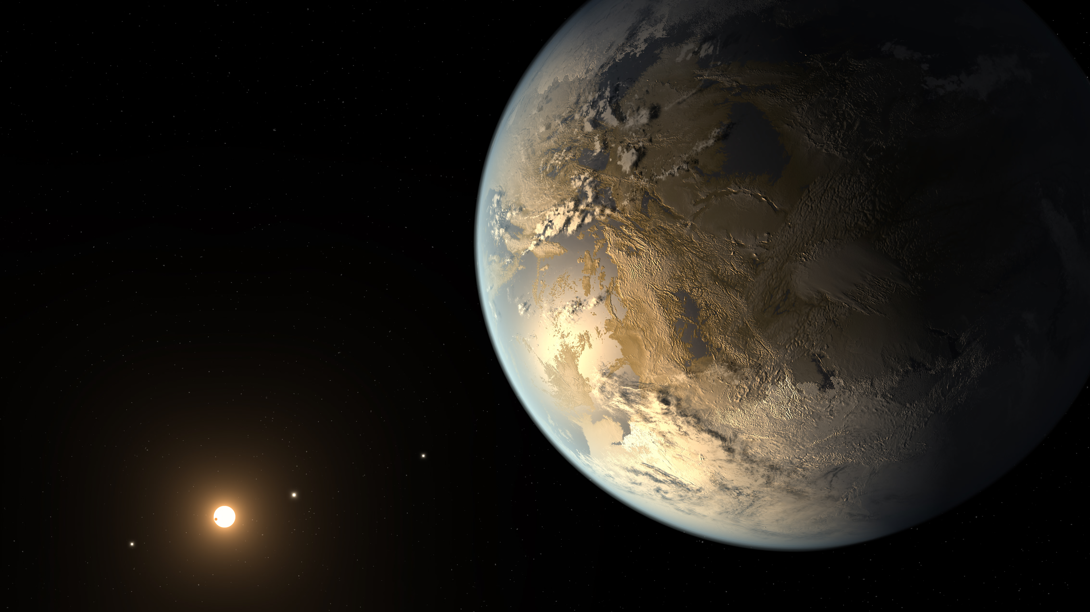

What is Exoplanet Yield and How Do We Calculate It?
Christopher Stark
NASA GSFC

Slide 19
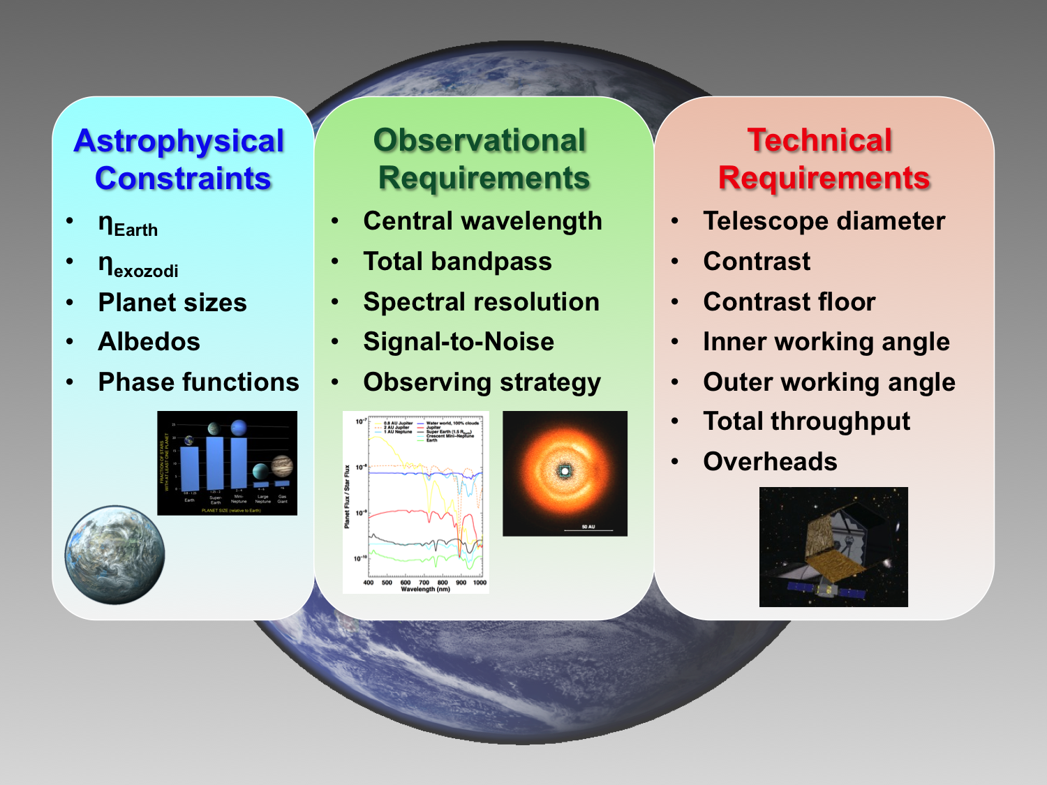
Exoplanet Yield via Mission Simulation
DRM

Slide 20
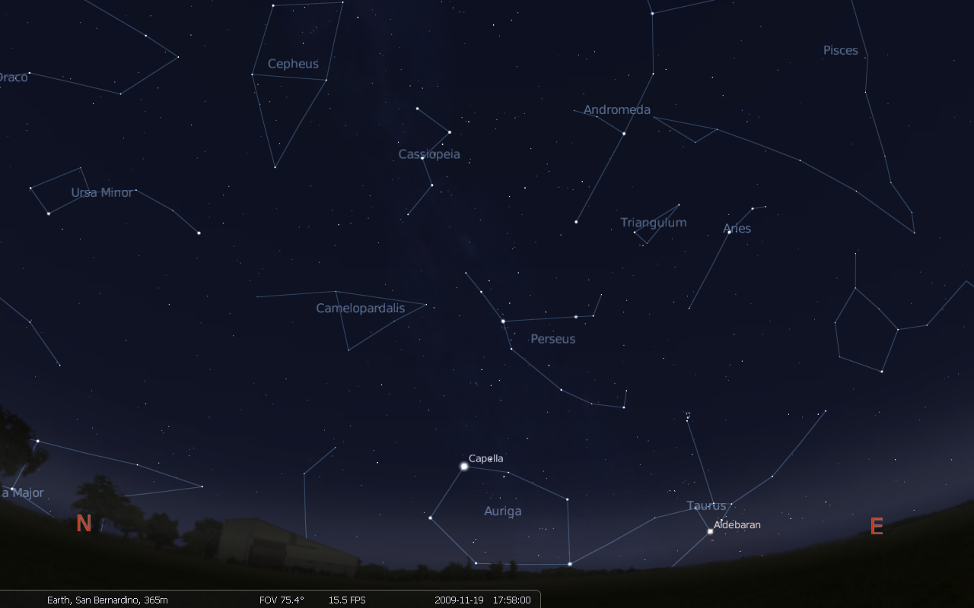
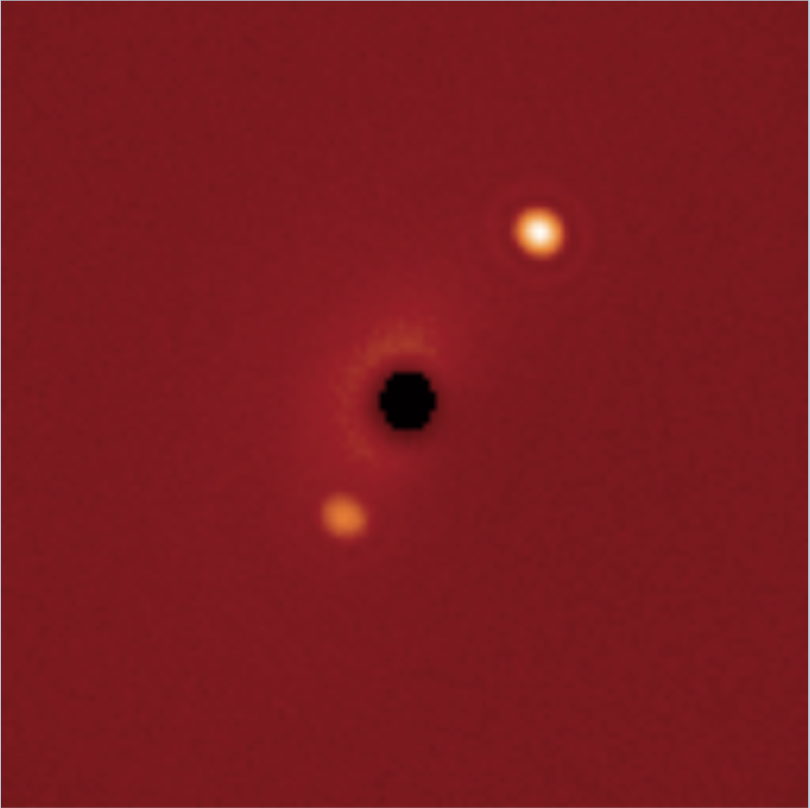
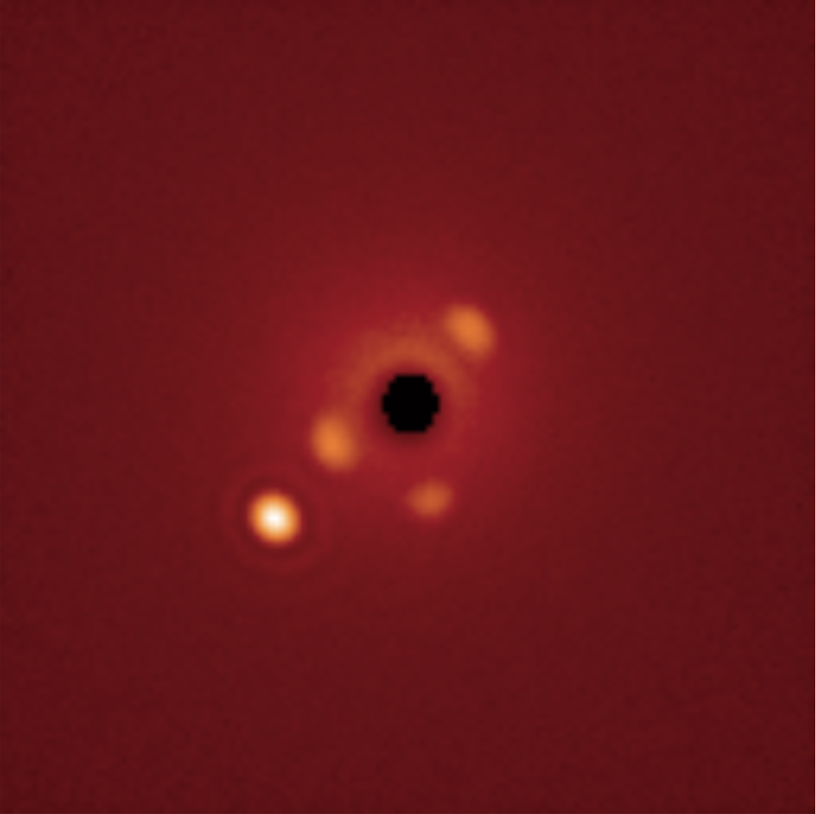
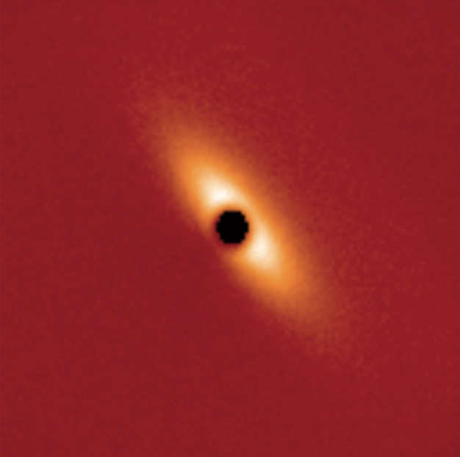
Exoplanet Yield via Mission Simulation
Notes:
- We simulate Earth-like planets around known nearby stars
Then we simulate a space telescope observing those stars
Eta Cassiopia, Upsilon Andromedae, Iota Persei

Slide 21
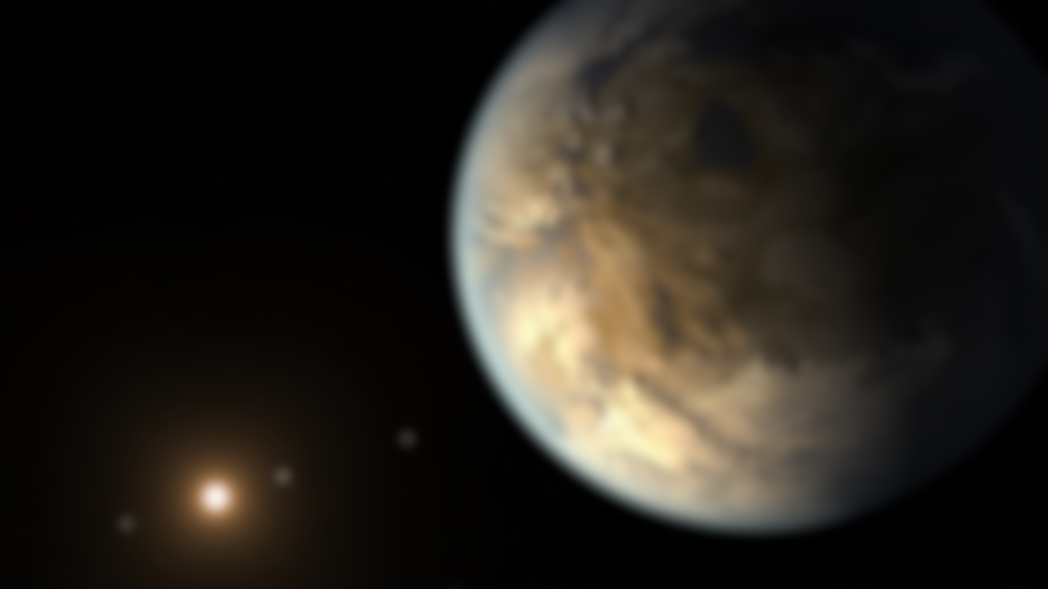
The Two Major Components of Yield Calculators
An exposure time calculator (ETC)
Must be very rapid (~10 billion calculations in a typical yield run)
Must capture the important aspects of planetary systems and reasonable fidelity
Must capture the important aspects of coronagraph performance at reasonable fidelity
A completeness calculator
Determines the probability of detecting a planet if that planet exists
Used to prioritize and optimize observations
Completeness and exposure time are connected!
Notes:
Completeness calculated via Monte Carlo simulation
Distribute a “cloud” of synthetic exoplanets & calculate separation & magnitude
IWA & OWA block some planets
Others (crescent-phase) are so faint that their exposure times are too long
Completeness is a function of exposure time!

Slide 22
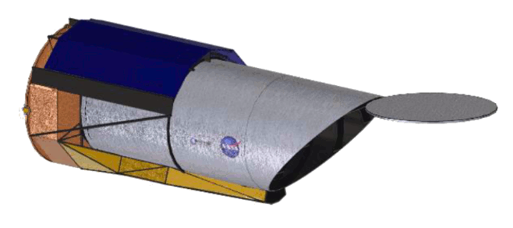
Exoplanet Yield & Completeness
τ
Too faint
HZ
IWA
Completeness, C = the chance of observing a given planet around a given star if that planet exists (Brown 2004)
Yield = η_{Earth} Σ C
Calculated via a Monte Carlo simulation with synthetic planets
Notes:
Completeness calculated via Monte Carlo simulation
Distribute a “cloud” of synthetic exoplanets & calculate separation & magnitude
IWA & OWA block some planets
Others (crescent-phase) are so faint that their exposure times are too long
Completeness is a function of exposure time!

Slide 23
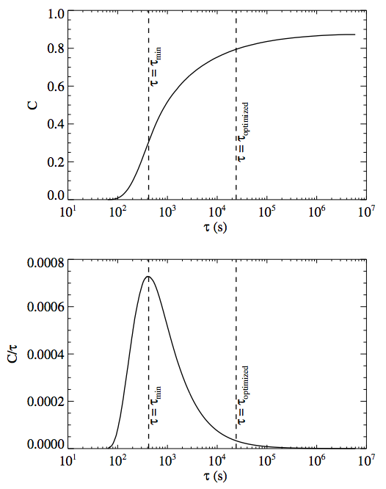
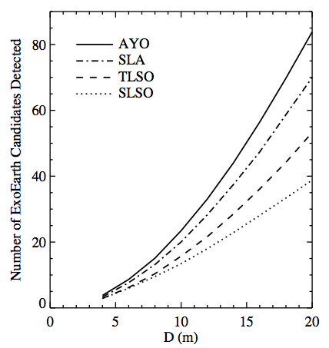
Maximizing Yield by Optimizing Observations
Optimized Exposure Times
Optimally distributing exposure time can potentially double yield

Slide 24
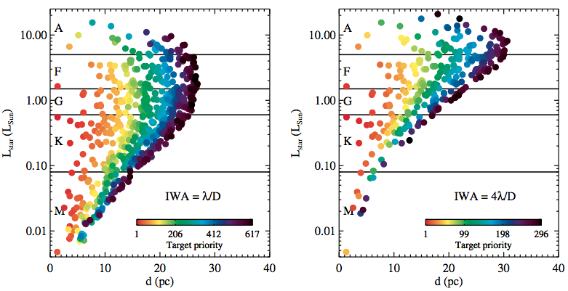
Optimization Helps Prevent Ignorant Decisions
IWA = λ/D
IWA = 4λ/D
Optimizing the observation plan is critical to yield estimates, as it ensures that we are always playing to the strengths of the mission

Slide 25
If Once Wasn’t Enough, Look Again
τ
Too faint
HZ
IWA
Revisiting same star multiple times can increase total completeness
Can optimize number of visits and delay time between visits
Notes:
Completeness calculated via Monte Carlo simulation
Distribute a “cloud” of synthetic exoplanets & calculate separation & magnitude
IWA & OWA block some planets
Others (crescent-phase) are so faint that their exposure times are too long
Completeness is a function of exposure time!

Slide 26
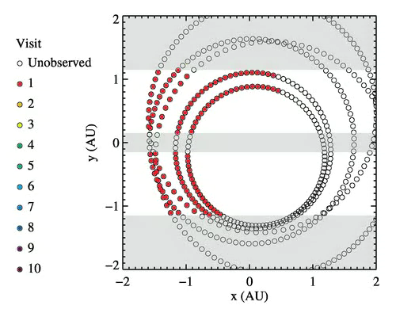
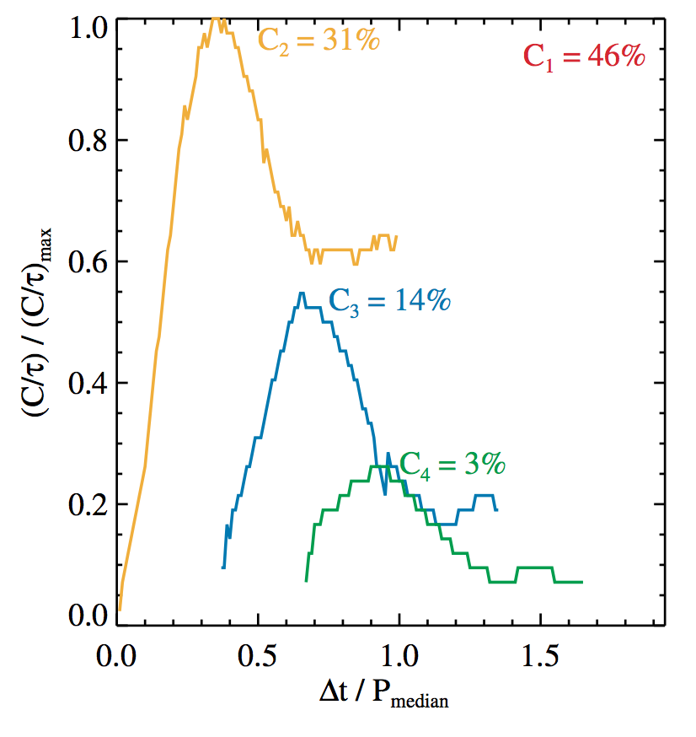
Optimizing revisits
Optimized revisits can increase yield by additional 35-75%

Slide 27
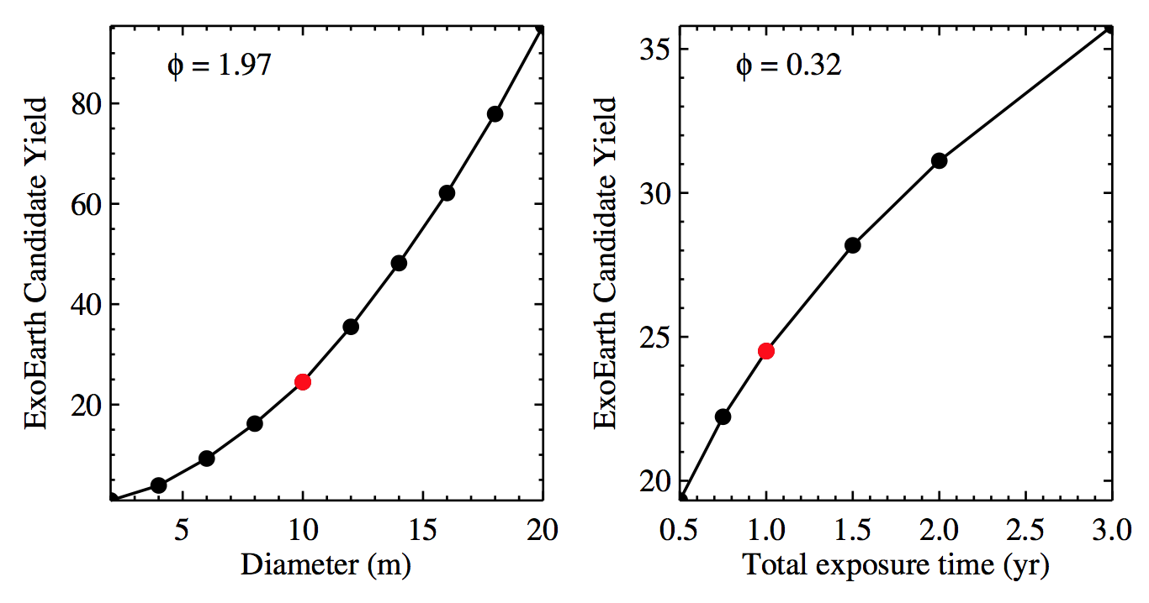
Lessons Learned from Toy Models
Yield ∝ D^{1.9}
Yield ∝ t^{0.3}
Stark et al. (2014)
Yield of a coronagraph-based mission is most sensitive to aperture size.

Slide 28

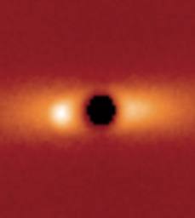
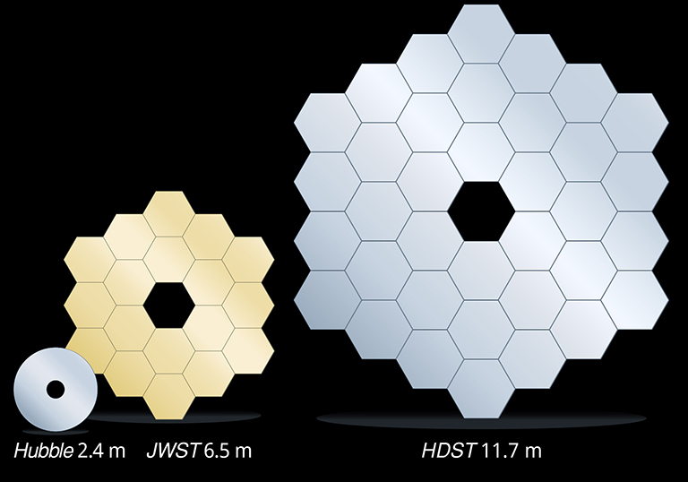
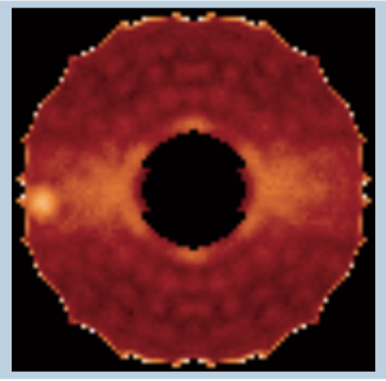
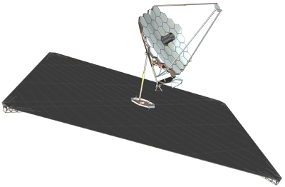
Why Coronagraph Yield is Most Sensitive to D
Larger photon bucket
Smaller IWA
~ λ/D
Sharper PSF
4 m
12 m
Exposure time scales as D⁻⁴

Slide 29
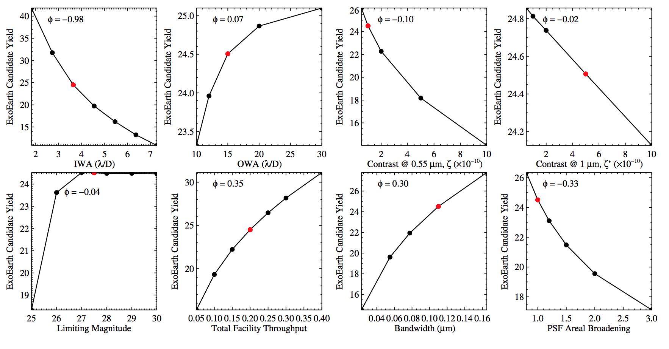
Lessons Learned from Toy Models
Stark et al. (2014)
Yield is a modest/weak function of all other parameters. However, other parameters can have many more knobs to turn!

Slide 30
DRMs have come a long way
LUVOIR & HabEx DRMs used realistic optical layouts
Key points:
The reflectivity of coatings matters a lot!
i.e., 0.95^12 = 0.5
We will likely have to trade bandwidth for throughput. UV coronagraphy reduces throughput at all wavelengths by up to ~0.5
Efficiently parallelizing coronagraphs may be essential for wavelength coverage
Stark et al. (2019)

Slide 31
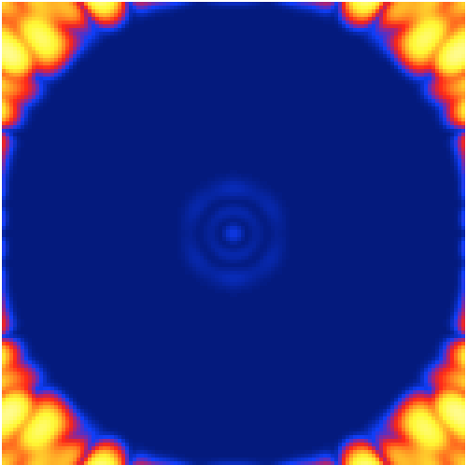
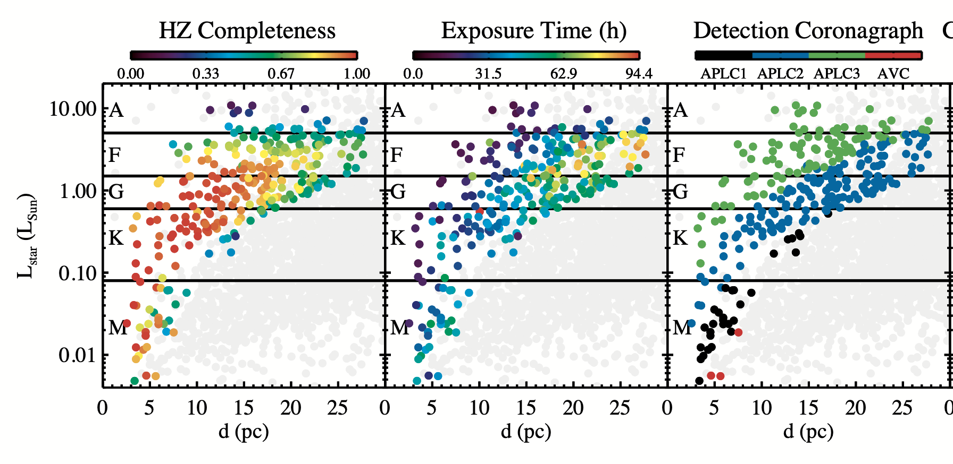
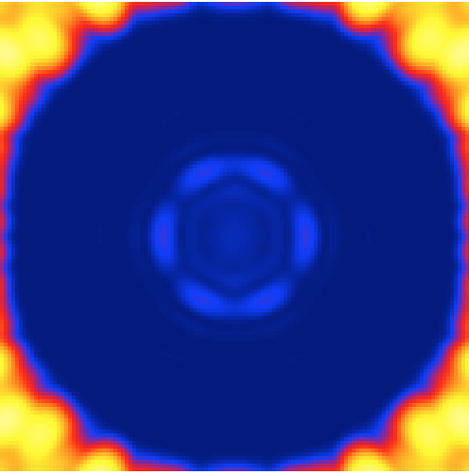
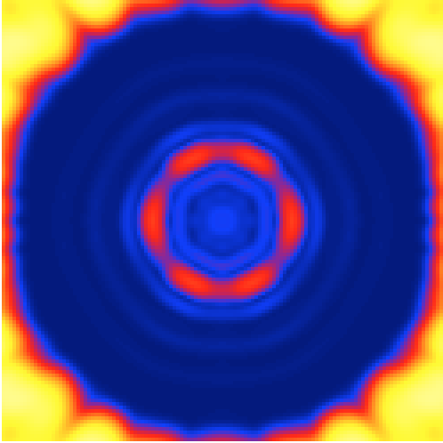
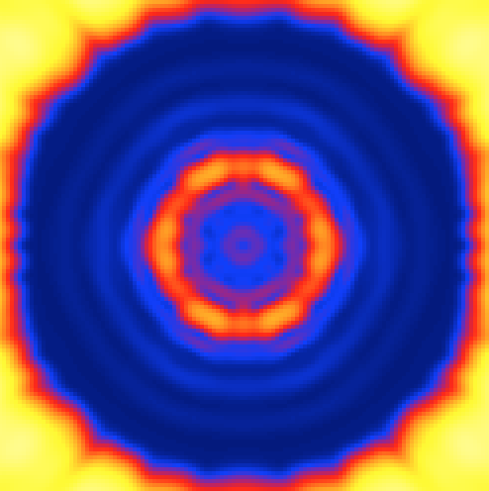
DRMs have come a long way
LUVOIR & HabEx DRMs used realistic coronagraph simulations
θ★
Key points:
One coronagraph doesn’t have to do it all. We can design different coronagraphs for different stars
Working within the IWA is not out of the question for some coronagraphs
Zimmerman/Soummer/St. Laurent
We assigned simulated 2D leaked starlight to each star as a function of stellar diameter
We used 2D off-axis simulated PSFs to calculate planet’s flux
LUVOIR Final Report (2019)
DRM optimally assigned LUVOIR-A’s 4 coronagraph masks to stars.

Slide 32
Coronagraph Performance
Contrast, Throughput, IWA, and OWA
LUVOIR-B DM-Assisted Vortex Coronagraph
There are many other parameters that also matter: bandwidth, sensitivity to stellar diameter & aberrations, etc.
IWA
Credit: G. Ruane

Slide 33
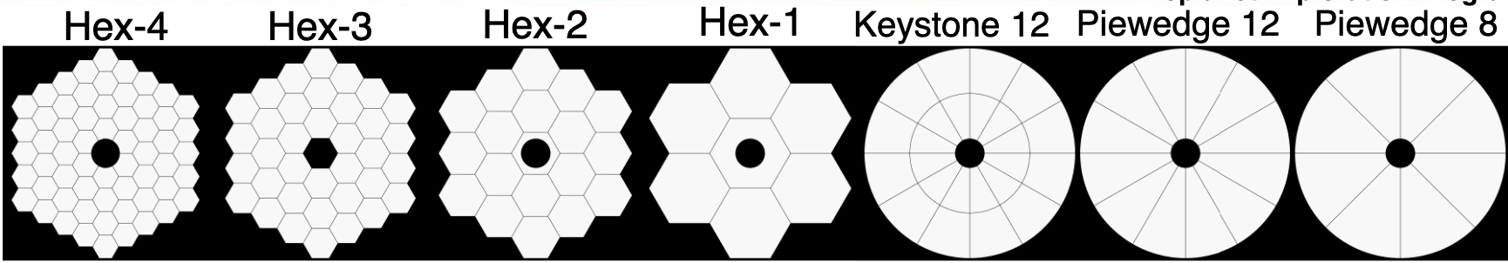
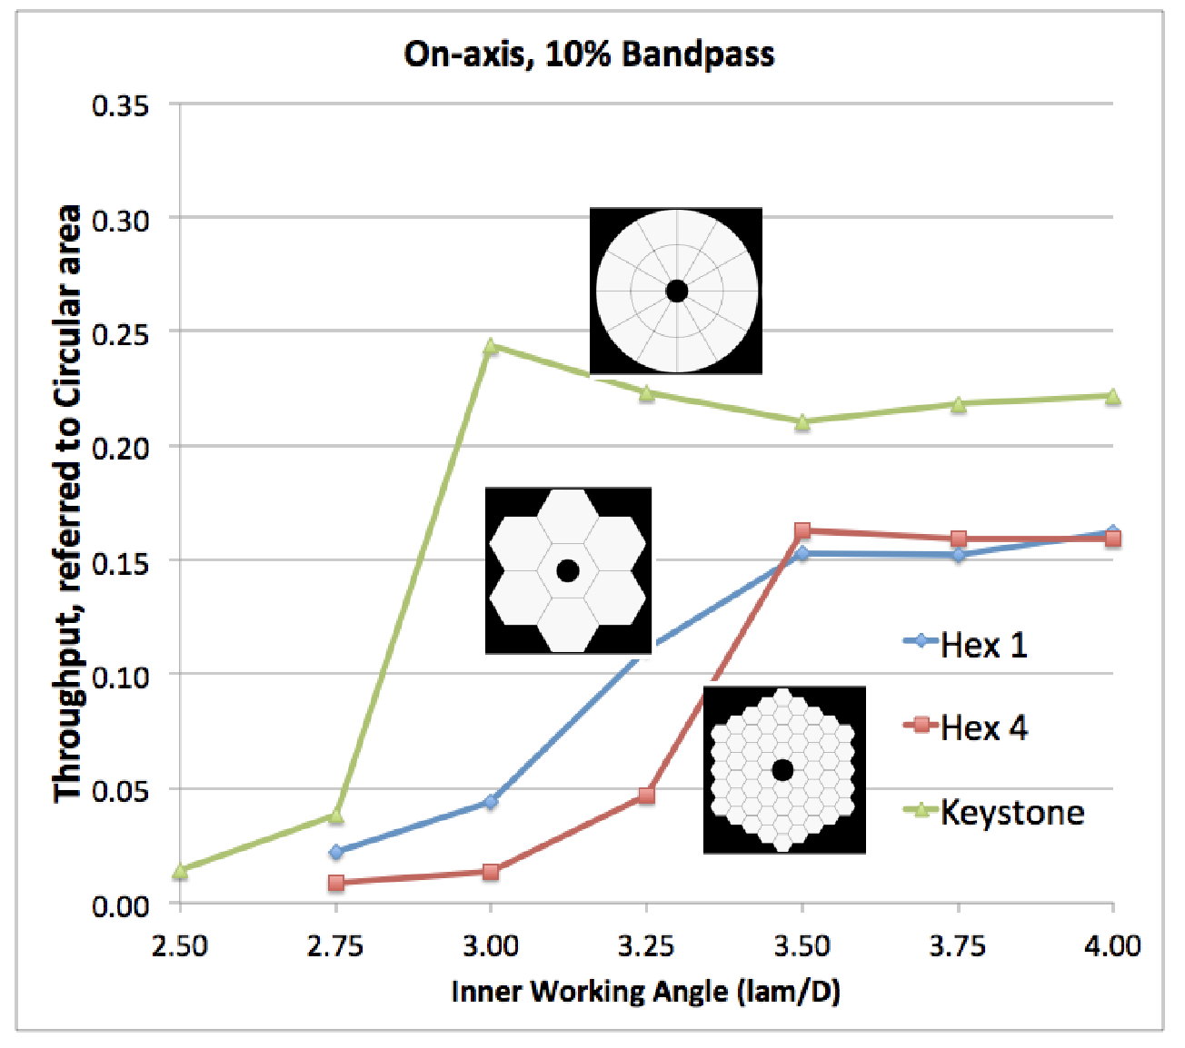
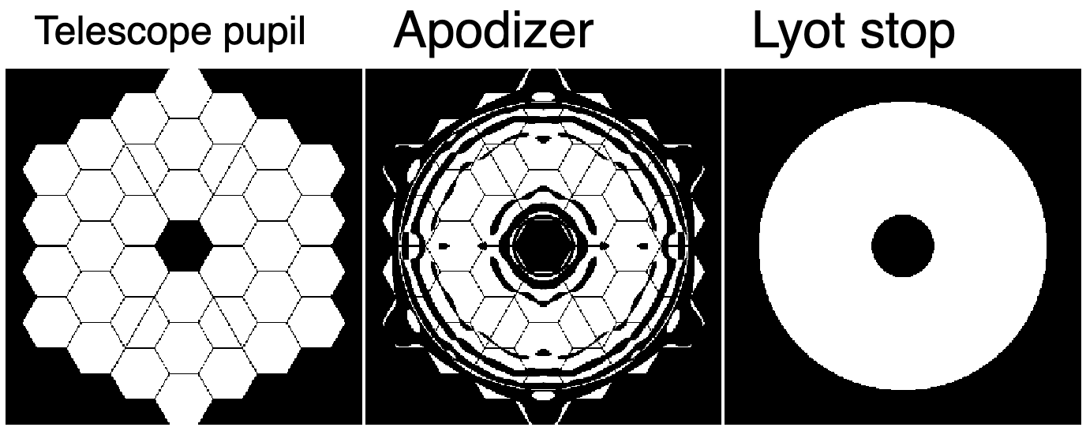
DRMs have come a long way
LUVOIR & HabEx DRMs used realistic coronagraph simulations
ExEP’s SCDA Study was essential to understanding the coronagraph design trade space and system-level requirements.
Key points:
PM & SM geometry matters a lot—must design at system level!
Coronagraph mask design has non-intuitive trades (OWA vs bandwidth, contrast vs IWA, etc.). Improving one parameter often comes at the expense of others.
Slides from Shaklan (2016), many papers from SCDA Team
Notes:
LUVOIR-A was redesigned halfway through the study due to lessons from SCDA.

Slide 34
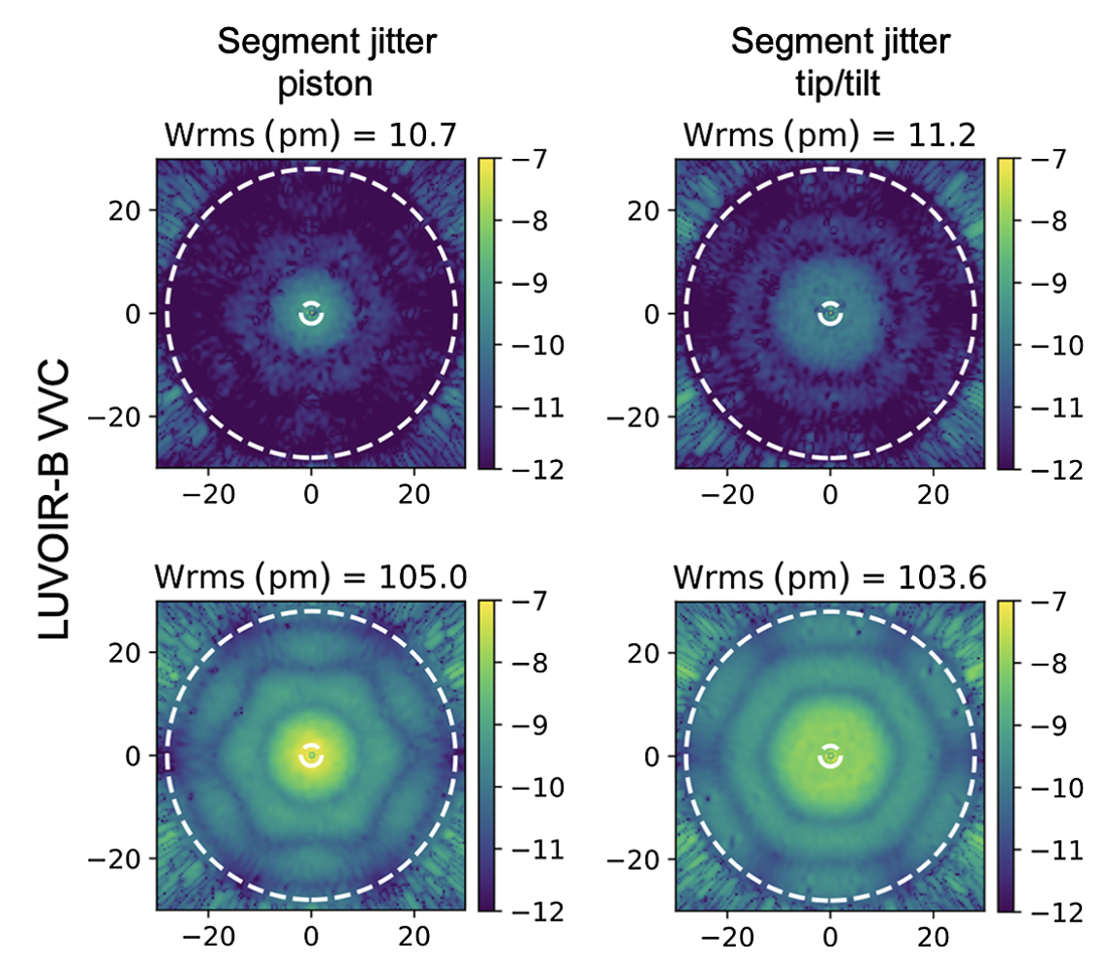
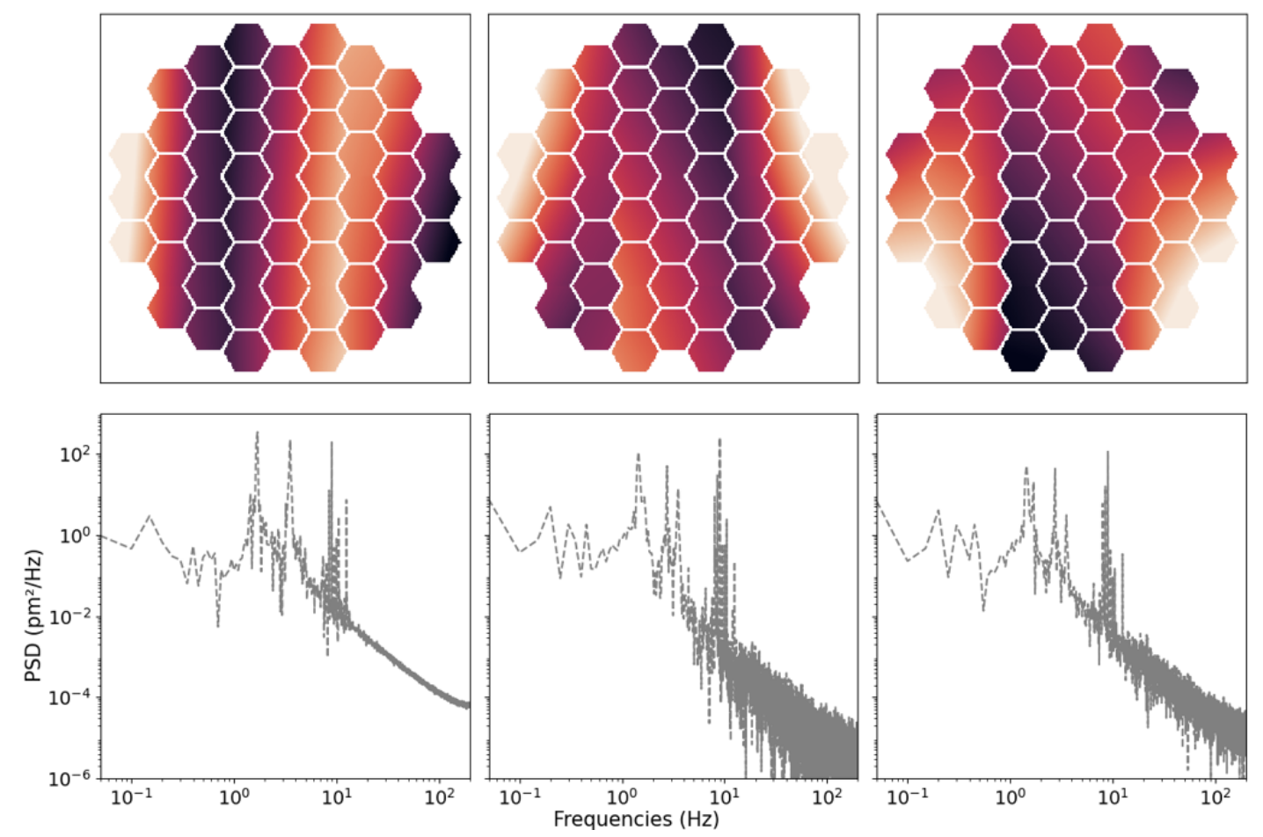
DRMs have come a long way
Recent DRMs include simulated noise floors via dynamic aberrations
Juanola-Parramon et al. (2022)
Parameterized impact of dynamic disturbances on LUVOIR B.
Key points:
The noise floor is one of the most important instrument requirements to get right. We need confidence in these simulations.
We can now iterate between engineering simulations and coronagraph simulations to minimize key aberrations
Potier et al. (2022)
Used the WFE time series from ULTRA study to model noise floor of LUVOIR B.
Notes:
You can integrate over static contrast, but you can’t integrate over time variable speckles that set the systematic noise floor.
Most yield sensitivities are graceful—not the noise floor! If we get it wrong, we lose our science.

Slide 35
The ExoEarth Yield Landscape
Stark et al. (2019)

Slide 36
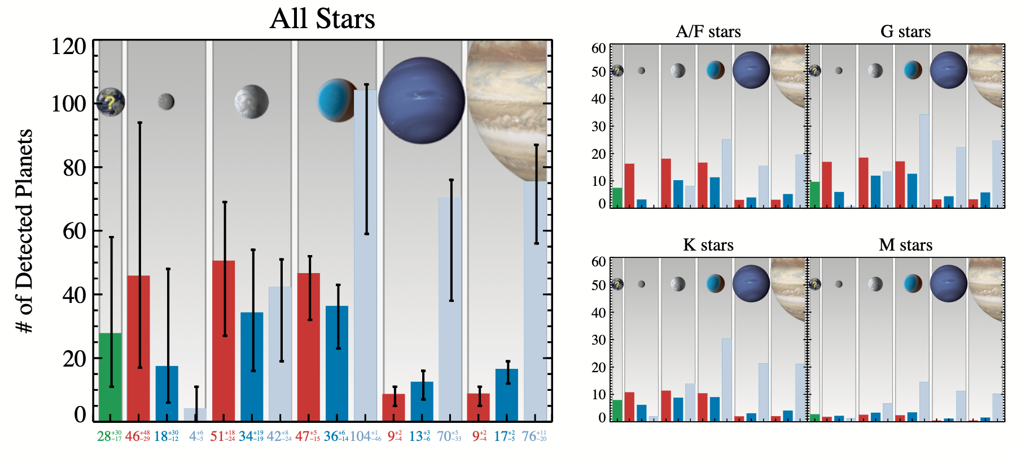
Example Output Products from Yield Calculators
Exoplanet Yields for a Variety of Planets

Slide 37
Example Output Products from Yield Calculators

Slide 38
Example Output Products from Yield Calculators

Slide 39
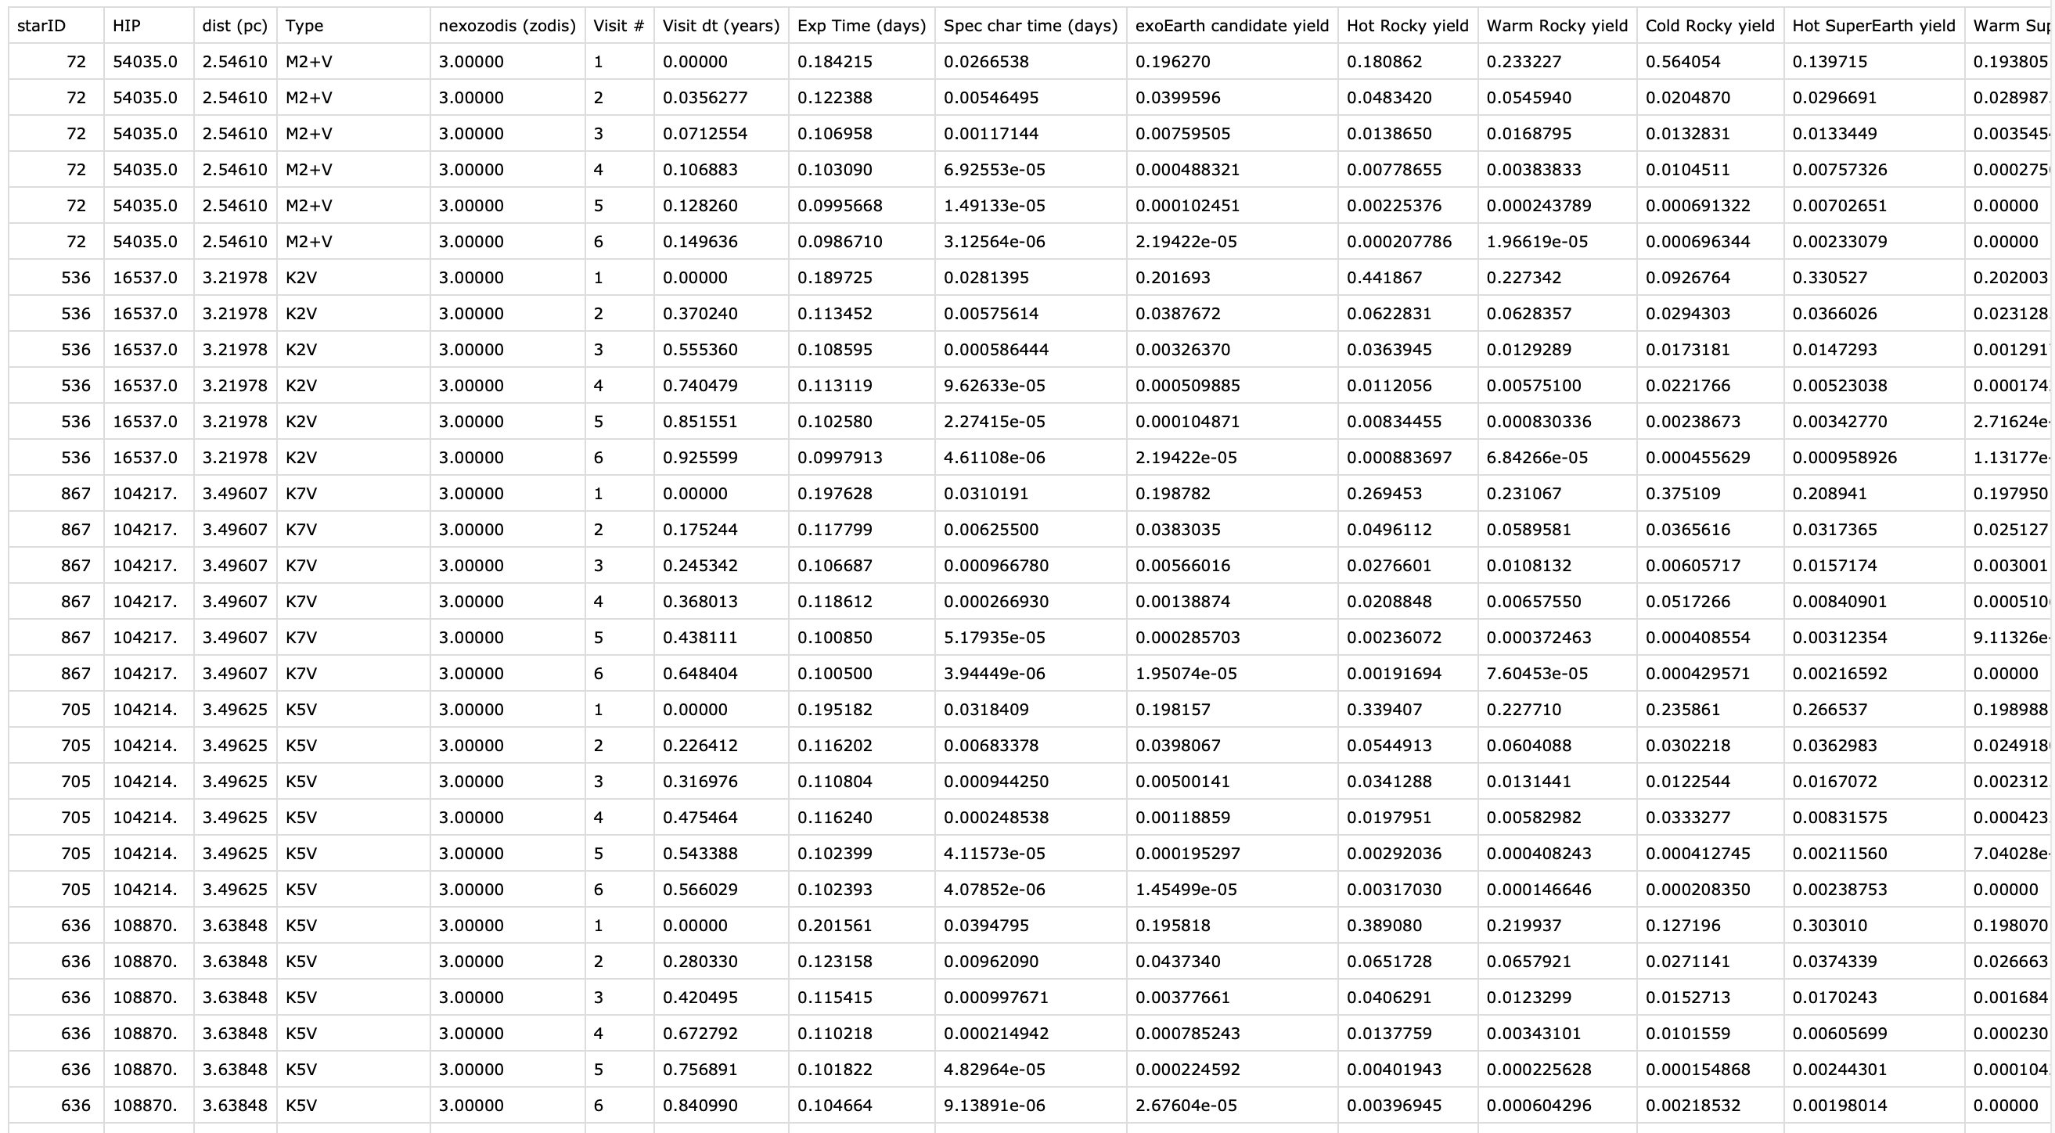
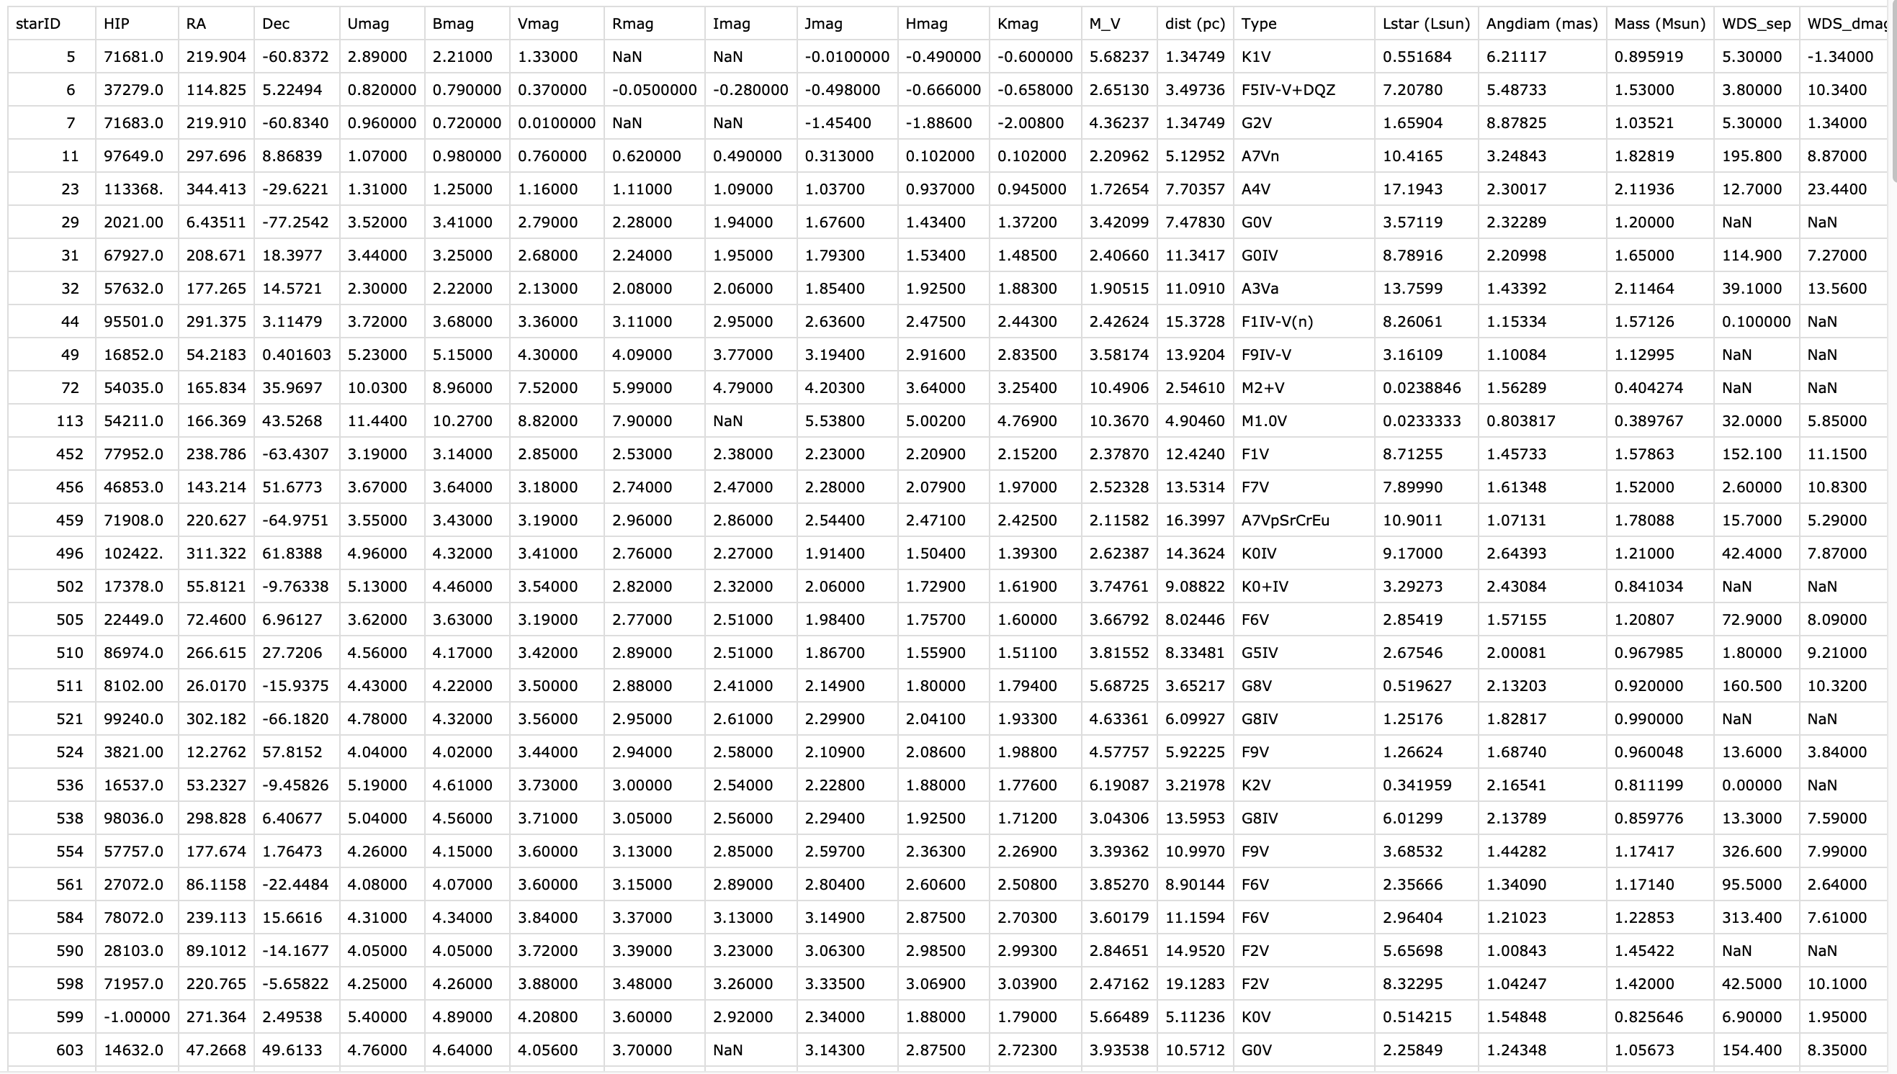
Example Output Products from Yield Calculators
Observations .csv file
Target list .csv file

Slide 40
In summary...
Exoplanet yield calculation for a high contrast imaging survey requires an exposure time calculator and a completeness calculator, as well as a long list of input assumptions.
Maximizing the potential yield of a mission requires making optimized decisions.
Modern yield calculators take into account realistic coronagraph performance at reasonably high fidelity.
Exoplanet yield calculators provide the machinery to flow science requirements to mission requirements by estimating science productivity and science yield sensitivities.

